Slide 1

Hadoop
By: Dr. Devpriya Soni
Department of Computer Science and Engineering & IT
Jaypee Institute of Information Technology, Noida
Notes:
Frequently, presenters must deliver material of a technical nature to an audience unfamiliar with the topic or vocabulary. The material may be complex or heavy with detail. To present technical material effectively, use the following guidelines from Dale Carnegie Training®.
Consider the amount of time available and prepare to organize your material. Narrow your topic. Divide your presentation into clear segments. Follow a logical progression. Maintain your focus throughout. Close the presentation with a summary, repetition of the key steps, or a logical conclusion.
Keep your audience in mind at all times. For example, be sure data is clear and information is relevant. Keep the level of detail and vocabulary appropriate for the audience. Use visuals to support key points or steps. Keep alert to the needs of your listeners, and you will have a more receptive audience.

Slide 2
Lecture will cover following points
Hadoop Basics
Hadoop Creation History
Applications
Features

Slide 3
What is Hadoop
An Open Source framework that allows distributed processing of large data-sets across the cluster of commodity hardware.
Distributed Processing:
Data is processed distributedly on multiple nodes / servers
Multiple machines processes the data independently
Cluster:
Multiple machines connected together
Nodes are connected via LAN
Commodity hardware:
Economic / affordable machines
Typically low performance hardware

Slide 4

Hadoop Creation History
Open source Apache software framework designed for storage and processing of large scale data on clusters of commodity hardware
Created by Doug Cutting and Mike Carafella in 2005.
Cutting named the program after his son’s toy elephant.

Slide 5
Hadoop
Written in Java
Inspired by Google's Map-Reduce programming model as well as its filesystem (GFS)
Runs on
Linux, Mac OS/X, Windows, and Solaris
Commodity hardware

Slide 6
Hadoop
Apache Hadoop software library is essentially a framework that allows for the distributed processing of large datasets across clusters of computers using a simple programming model.
Hadoop provides fast and reliable analysis of both structured data and unstructured data
Hadoop can scale up from single servers to thousands of machines, each offering local computation and storage.

Slide 7
Applications
Data-intensive text processing
Assembly of large genomes
Graph mining
Machine learning and data mining
Large scale social network analysis

Slide 8
Who uses hadoop
Facebook
500 TB per day
Yahoo
Over 170 PB
eBay
Over 6 PB
Twitter

Slide 9
Assumptions and Goals of Hadoop
Hardware Failure
Large Data Sets
Streaming Data Access (Best for batch processing)
Simple Coherency Model (write-once-read-many access model)
Portability Across Heterogeneous Hardware and Software Platforms

Slide 10
Hadoop Ecosystem Projects
Hadoop Ecosystem Projects includes:
Hadoop Common utilities
Avro: A data serialization system with scripting languages.
Chukwa: managing large distributed systems.
HBase: A scalable, distributed database for large tables.
HDFS: A distributed file system.
Hive: data summarization and ad hoc querying.
MapReduce: distributed processing on compute clusters.
Pig: A high-level data-flow language for parallel computation.
ZooKeeper: coordination service for distributed applications.

Slide 11
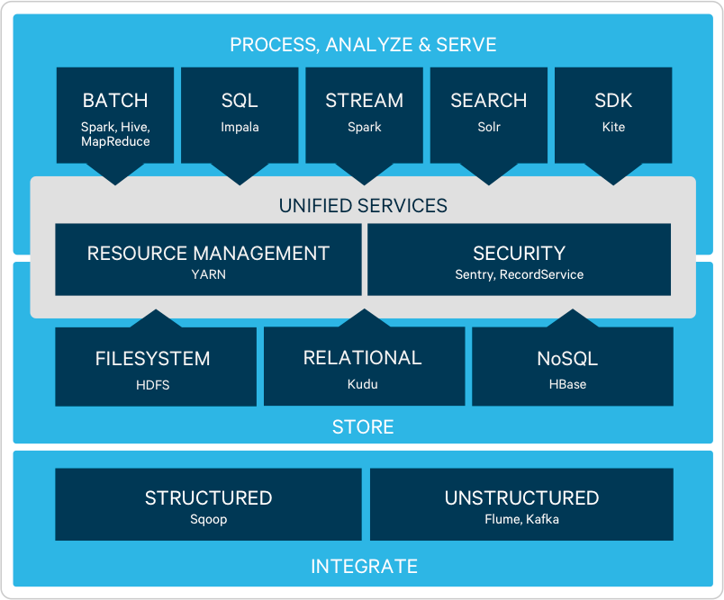
Only Hadoop is not going to solve all the problems we have to use sevral other tools over Hadoop or along with Hadoop to get the solution of all the problems that you have.

Slide 12
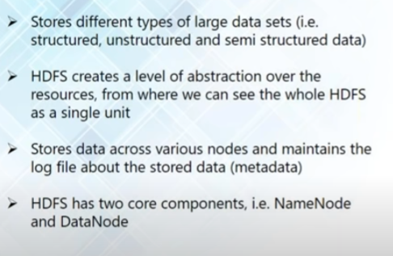
HDFS (Hadoop Distributed File System)- Storage

Slide 13
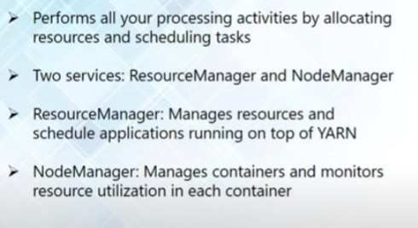
YARN ( Yet Another Resource Negotiator )

Slide 14
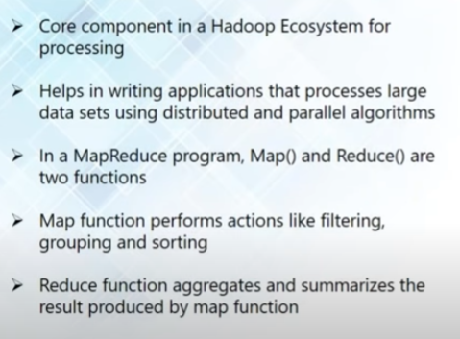
MapReduce : Data Processing using Programming

Slide 15
Thankyou

